Slide 1
CS2006 Operating Systems
SPRING 2023
National University of Computer and Emerging Sciences

Slide 2
Chapter 9
Main Memory

Slide 3
In this chapter, we discuss various ways to manage (shared) memory

Slide 4
Program must be brought (from disk) into memory shaping it a process to be run
Main memory and registers are only storage, CPU can access directly
any instructions in execution, and any data being used by the instructions, must be in one of these direct-access storage devices
Register access in one CPU clock (or less), Main memory can take many cycles, causing a stall
So Cache sits between main memory and CPU registers
Protection of memory required to ensure correct operation

Slide 5
Base and Limit Registers
A pair of base and limit registers define the logical address space
CPU must check every memory access generated in user mode to be sure it is between base and limit for that user
For example, if the base register holds 300040 and the limit register is 120900, then the program can legally access all addresses from 300040 through 420939 (inclusive)
only the operating system can load the base and limit registers
Any attempt by a program executing in user mode to access operating-system memory or other users’ memory results in a trap to the operating system, a fatal error

Slide 6
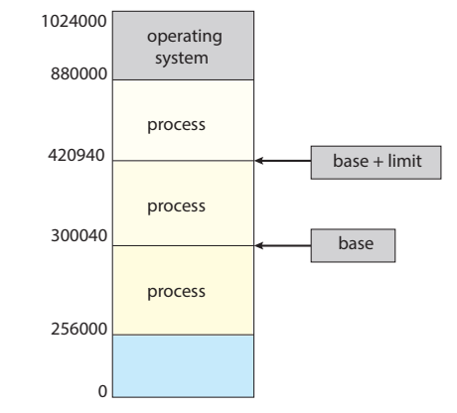

Slide 7
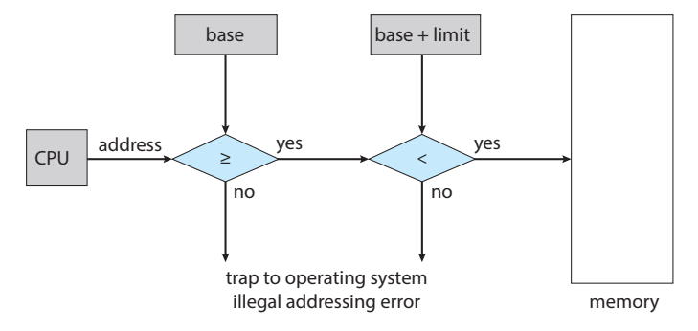

Slide 8
Address Binding
A user program, in most cases, goes through several steps before being executed.
Addresses may be represented in different ways during these steps.
Addresses in the source program are generally symbolic (such as the variable count).
A compiler typically binds these symbolic addresses to relocatable addresses (such as “14 bytes from the beginning of this module”).
The loader in turn binds the relocatable addresses to absolute addresses (such as 74014).
Each binding is a mapping from one address space to another.
Notes:
Address binding refers to the process of associating a logical or symbolic address used in a program with a physical address in memory
When a program is executed, it may contain references to memory locations that are not yet known or fixed. To execute the program, the system needs to map these logical addresses to physical addresses that correspond to actual memory locations in the system. This process is called address binding.

Slide 9
Address Binding
Address binding of instructions and data to memory addresses can happen at three different stages
Compile time: If memory location known a priori, absolute code can be generated; must recompile code if starting location changes
Load time: Compiler must generate relocatable code if memory location is not known at compile time. final binding is delayed until load time
Execution time: Binding delayed until run time if the process can be moved during its execution from one memory segment to another
Need hardware support for address maps (e.g., base and limit registers)

Slide 10
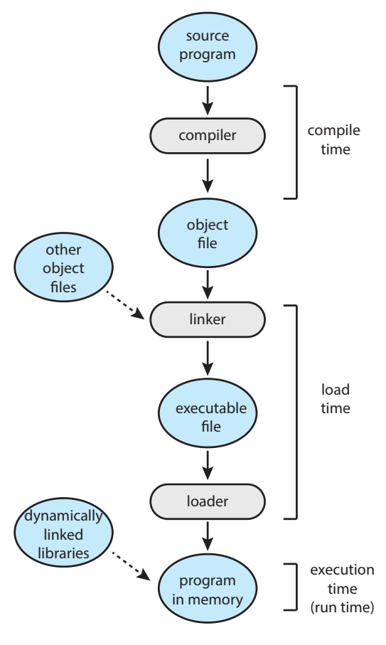

Slide 11
Logical Vs Physical Address Space
Logical address – generated by the CPU; also referred to as virtual address
Physical address – address seen by the memory unit
Logical and physical addresses are the same in compile-time and load-time address-binding schemes; logical (virtual) and physical addresses differ in execution-time address-binding scheme
Logical address space is the set of all logical addresses generated by a program
Physical address space is the set of all physical addresses corresponding to logical addresses

Slide 12
Memory Management Unit (MMU)
MMU is a hardware component of a computer system that manages the mapping between a program's logical memory addresses and the physical memory addresses where the data is stored.
The MMU is typically part of the central processing unit (CPU) or chipset and is responsible for translating logical addresses generated by a program into physical memory addresses
Many different methods to accomplish such mapping
One simple MMU scheme that is a generalization of the base register scheme. The base register is now called a relocation register.
The value in the relocation register is added to every address generated by a user process at the time the address is sent to memory, e.g. if the base is at 14000 an access to location 346 is mapped to location 14346.

Slide 13
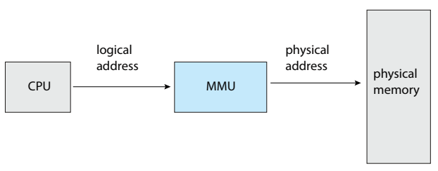
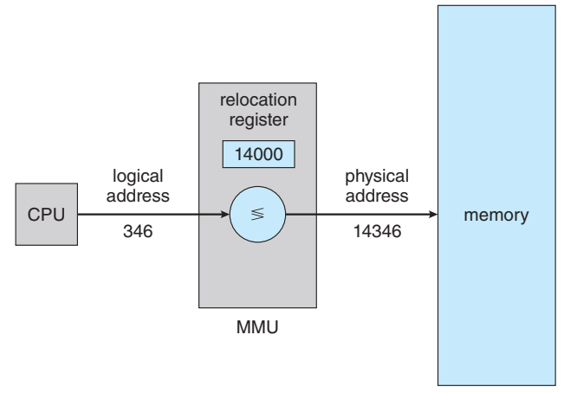

Slide 14
The user program deals with logical addresses; it never sees the real physical addresses
Execution-time binding occurs when reference is made to location in memory

Slide 15
Dynamic Loading
Dynamic loading obtains better memory-space utilization.
With dynamic loading, a routine is not loaded until it is called.
All routines are kept on disk in a relocatable load format.
The main program is loaded into memory and is executed.
When a routine needs to call another routine, the calling routine first checks to see whether the other routine has been loaded.
This method is particularly useful when large amounts of code are needed to handle infrequently occurring cases, such as error routines

Slide 16
Dynamic Linking and Shared Libraries
Dynamically linked libraries (DLLs) are system libraries that are linked to user programs when the programs are run.
dynamic linking loads the library code from a shared library file at runtime
Some operating systems support only static linking, in which system libraries are treated like any other object module and are combined by the loader into the binary program image
static linking embeds the library code into the application code at compile-time

Slide 17
A second advantage of DLLs is that these libraries can be shared among multiple processes, so that only one instance of the DLL in main memory.
For this reason, DLLs are also known as shared libraries, and are used extensively in Windows and Linux systems.
A library may be replaced by a new version, and all programs that reference the library will automatically use the new version.

Slide 18
Contiguous Memory Allocation
The main memory must accommodate both the operating system and the various user processes
The memory is usually divided into two partitions: one for the operating system and one for the user processes.
In contiguous memory allocation, each process is contained in a single section of memory that is contiguous to the section containing the next process

Slide 19
Memory Protection: How?
Relocation Register + Limit Register serve the purpose.
When the CPU scheduler selects a process for execution, the dispatcher loads the relocation and limit registers with the correct values as part of the context switch.
Because every address generated by a CPU is checked against these registers, we can protect both the operating system and the other users’ programs and data from being modified by this running process.
Notes:
The relocation-register scheme provides an effective way to allow the operating system’s size to change dynamically.

Slide 20
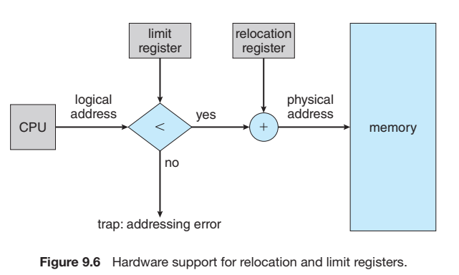

Slide 21
Memory Allocation
One of the simplest methods of allocating memory is to assign processes to variably sized partitions in memory, where each partition may contain exactly one process
In this variable partition scheme, the operating system keeps a table indicating which parts of memory are available and which are occupied.
Initially, all memory is available for user processes and is considered one large block of available memory

Slide 22
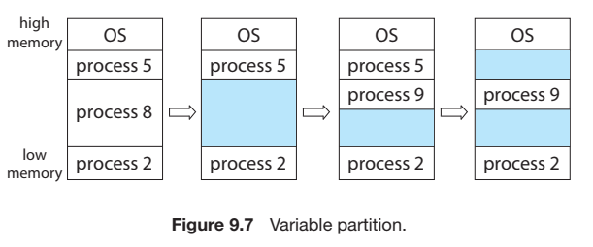

Slide 23
As processes enter the system, the operating system takes into account the memory requirements of each process and the amount of available memory space in determining which processes are allocated memory.
When a process is allocated space, it is loaded into memory, where it can then compete for CPU time.
When a process terminates, it releases its memory, which the operating system may then provide to another process

Slide 24
When a process arrives and needs memory, the system searches the set for a hole that is large enough for this process.
This procedure is a particular instance of the general dynamic storage allocation problem
There are many solutions to this problem. The first-fit, best-fit , and worst-fit strategies are the ones most commonly used to select a free space from the set of available holes

Slide 25
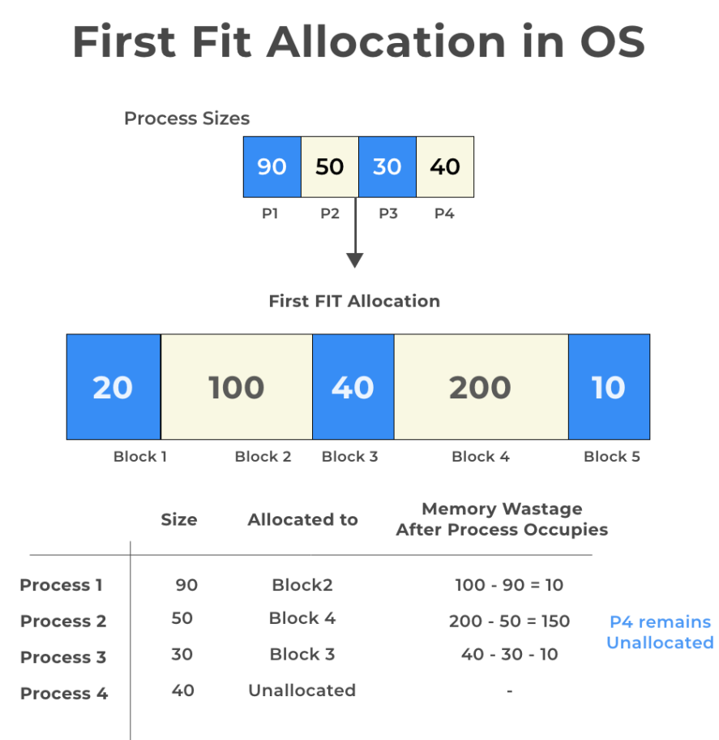

Slide 26
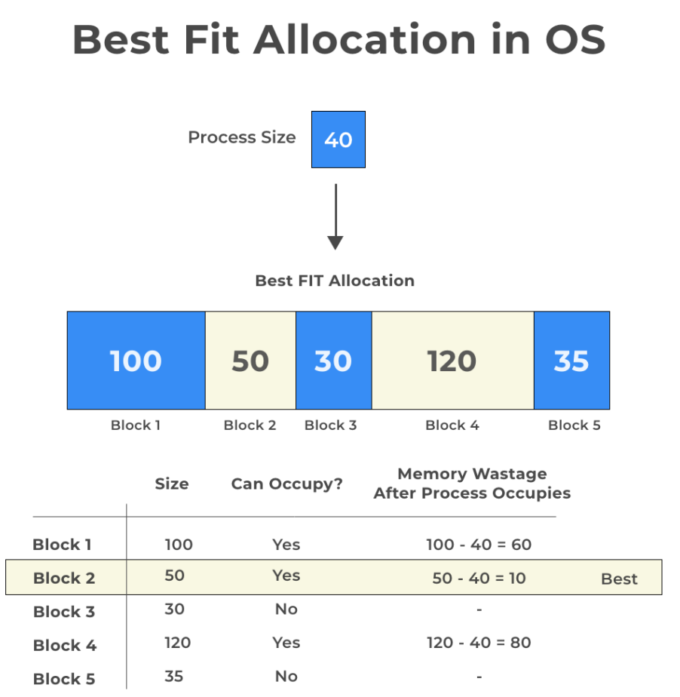

Slide 27
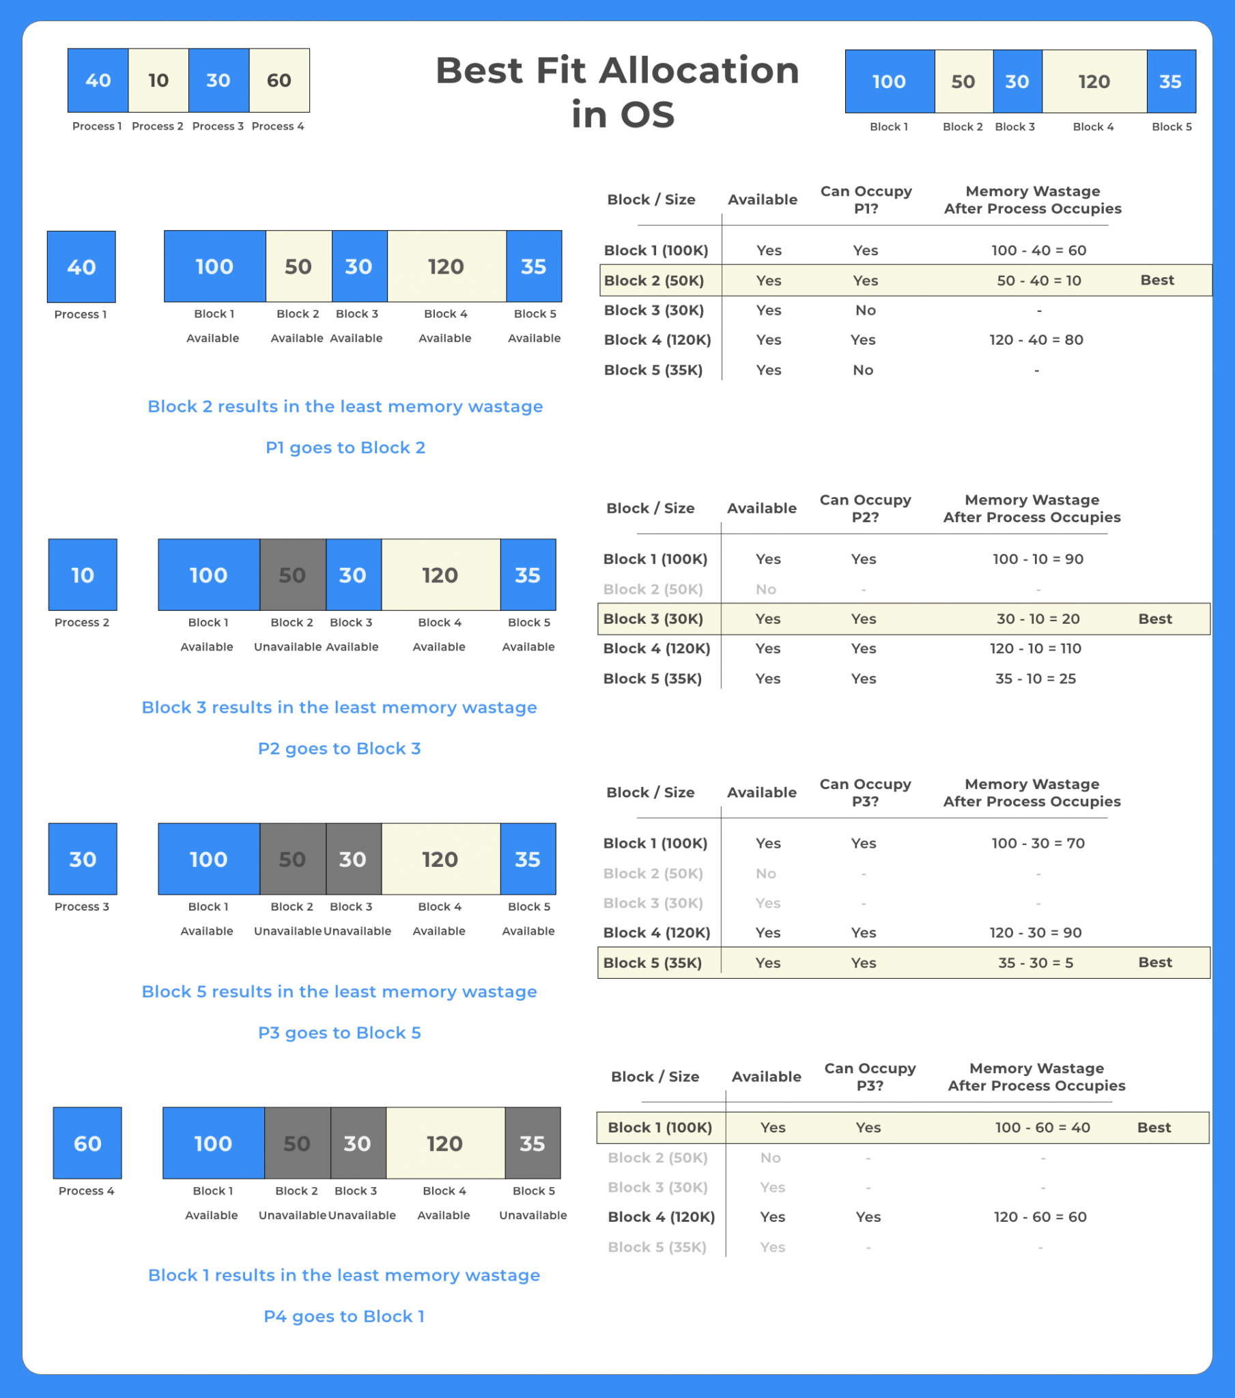

Slide 29
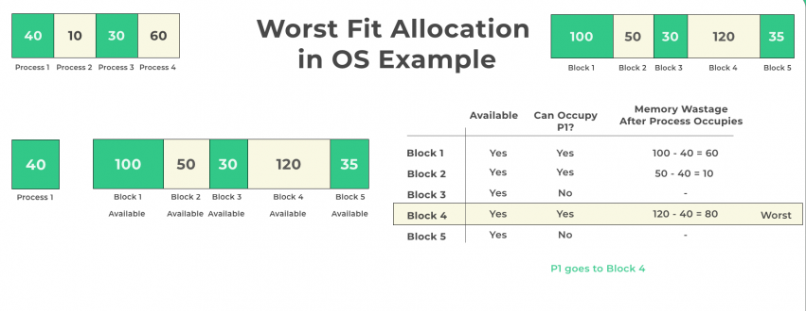

Slide 30
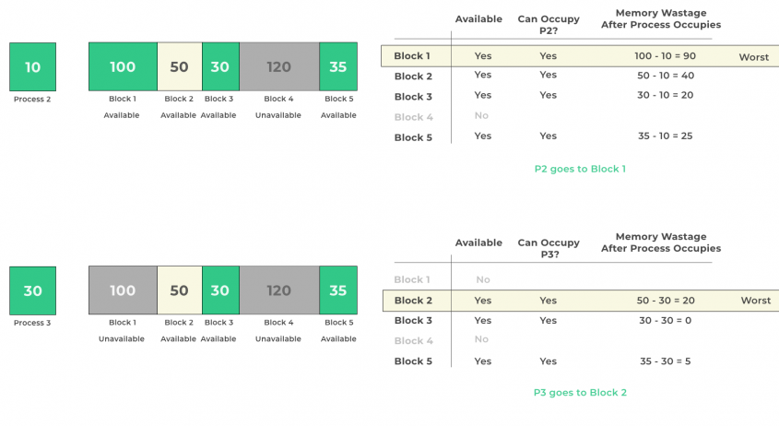

Slide 31
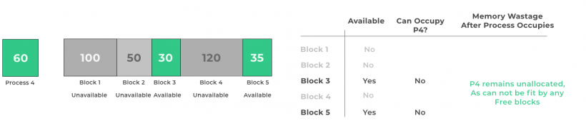

Slide 32
Simulations have shown that both first fit and best fit are better than worst fit in terms of decreasing time and storage utilization.
Neither first fit nor best fit is clearly better than the other in terms of storage utilization, but first fit is generally faster.

Slide 33
Fragmentation
External Fragmentation – total memory space exists to satisfy a request, but it is not contiguous
Internal Fragmentation – allocated memory may be slightly larger than requested memory; this size difference is memory internal to a partition, but not being used
First fit analysis reveals that given N blocks allocated, 0.5 N blocks lost to fragmentation
1/3 may be unusable -> 50-percent rule

Slide 34
Compaction
Reduce external fragmentation by compaction
Shuffle memory contents to place all free memory together in one large block
Compaction is possible only if relocation is dynamic, and is done at execution time
From time to time, the OS shifts the processes so they are contiguous and all of the free memory is together in one block

Slide 35
Paging
Paging, a memory management scheme that permits a process’s physical address space to be noncontiguous.
Paging avoids external fragmentation and the need for compaction
Paging involves breaking physical memory into fixed-sized blocks called frames and breaking the program(process) into blocks of the same size called pages
When a process is to be executed, its pages are loaded into any available memory frames
At a given point in time, some of the frames in memory are in use, and some are free. A list of free frames is maintained by the OS

Slide 36
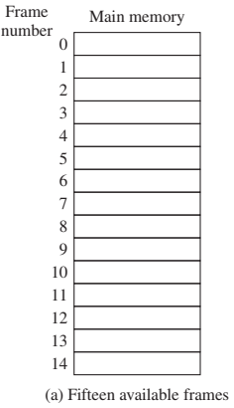
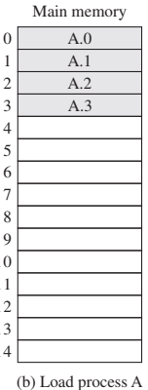
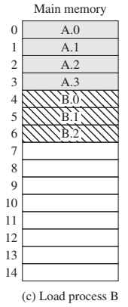
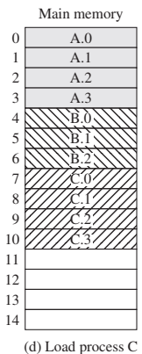
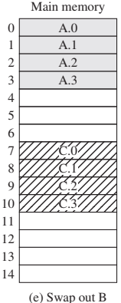
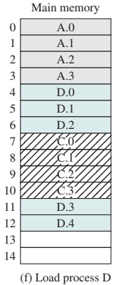

Slide 37
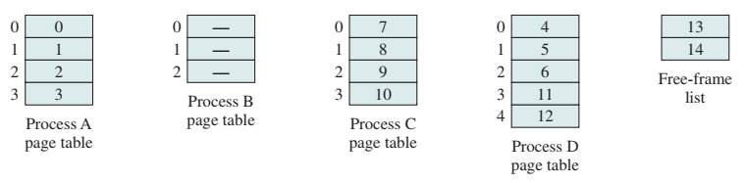
A simple base address register will no longer suffice. Rather, the operating system maintains a page table for each process

Slide 38
The page size (like the frame size) is defined by the hardware.
The size of a page is a power of 2, typically varying between 4 KB and 1 GB per page

Slide 39

Address Translation Scheme
Address generated by CPU is divided into:
Page number (p) – used as an index into a page table which contains base address of each page in physical memory
Page offset (d) – combined with base address to define the physical memory address that is sent to the memory unit

Slide 40
Address Translation Scheme
The following outlines the steps taken by the MMU to translate a logical address generated by the CPU to a physical address:
Extract the page number p and use it as an index into the page table.
Extract the corresponding frame number f from the page table.
Replace the page number p in the logical address with the frame number f.

Slide 41

If the size of the logical address space is 2^{m}, and a page size is 2^{n} bytes, then the high-order m – n bits of a logical address designate the page number, and the n low-order bits designate the page offset

Slide 42
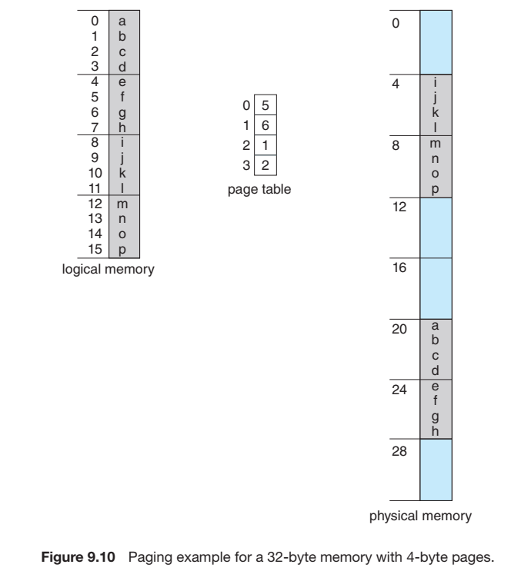
m = 4
n = 2

Slide 43
e.g.
Using a page size of 4 bytes and a physical memory of 32 bytes (8 pages), we show how the programmer’s view of memory can be mapped into physical memory.
Logical address 0 is page 0 offset 0. Indexing into the page table, we find that page 0 is in frame 5. Thus, logical address 0 maps to physical address 20 [= (5 × 4) +0].
Logical address 3 (page 0, offset 3) maps to physical address 23 [= (5 × 4) +3]
Logical address 4 is page 1, offset 0; according to the page table, page 1 is mapped to frame 6. Thus, logical address 4 maps to physical address 24 [= (6 × 4) + 0].
Logical address 13 maps to physical address 9

Slide 44
Free Frames
Since the operating system is managing physical memory, it must be aware of the allocation details of physical memory—which frames are allocated, which frames are available, how many total frames there are, and so on.
This information is generally kept in a single, system-wide data structure called a frame table

Slide 45
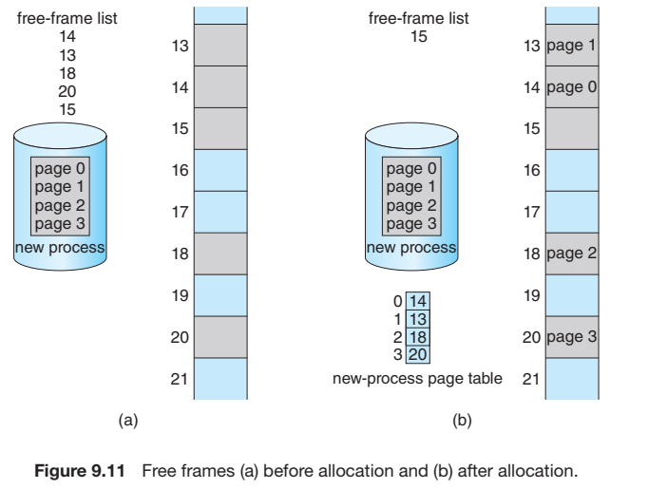

Slide 46
Hardware Support
As page tables are per-process data structures, a pointer to the page table is stored with the other register values (like the instruction pointer) in the process control block of each process.
For the machines with huge page tables, the page table is kept in main memory, and a page-table base register (PTBR) points to the page table
PTLR asdfasd

Slide 47
Protection
Memory protection is implemented by associating protection bit with each frame to indicate if read-only or read-write access is allowed
At the same time that the physical address is being computed, the protection bits can be checked to verify that no writes are being made to a read-only page
Valid-invalid bit attached to each entry in the page table:
“valid” indicates that the associated page is in the process’ logical address space, and is thus a legal page
“invalid” indicates that the page is not in the process’ logical address space
Some systems provide hardware, in the form of a page-table length register (PTLR), to indicate the size of the page table

Slide 48
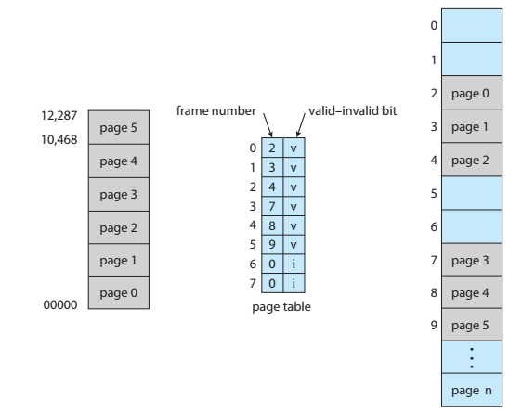

Slide 49
Shared Pages
An advantage of paging is the possibility of sharing common code.
E.g. the standard C library
Reentrant (Read-only) code shared among processes
Only one copy of the shared library needs be kept in physical memory, and the page table for each user process maps onto the same physical copy of that library.
The shared libraries are typically implemented with shared pages.
To be sharable, the code must be reentrant; the operating system should enforce this property.

Slide 50
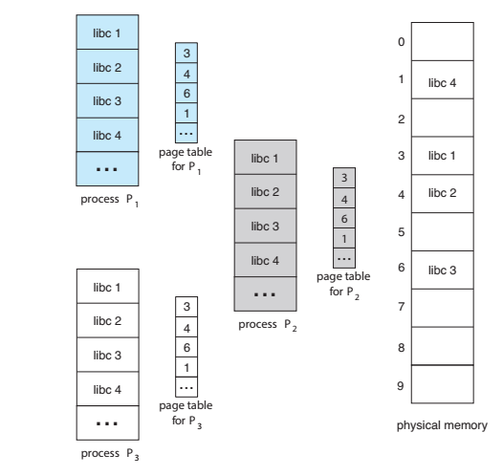

Slide 51
Segmentation
A user program can be subdivided using segmentation, in which the program and its associated data are divided into a number of segments
It is not required that all segments of all programs be of the same length, although there is a maximum segment length.
A logical address using segmentation consists of two parts, in this case, a segment number and an offset.
Because of the use of unequal-size segments, segmentation is similar to dynamic partitioning
The difference is that with segmentation a program may occupy more than one partition, and these partitions need not be contiguous

Slide 52
A segment is a logical unit such as: main program
Procedure
Function
Method
Object
local variables, global variables
…
When a process is brought in, all of its segments are loaded into available regions of memory, and a segment table is set up

Slide 53
Segmentation eliminates internal fragmentation but, like dynamic partitioning, it suffers from external fragmentation.
Whereas paging is invisible to the programmer, segmentation is usually visible and is provided as a convenience for organizing programs and data.
Typically, the programmer or compiler will assign programs and data to different segments.

Slide 54
A simple segmentation scheme would make use of a segment table for each process, and a list of free blocks of main memory.
Each segment table entry would have to give the starting address in main memory of the corresponding segment.
Segment-table base register (STBR) points to the segment table’s location in memory
The entry should also provide the length of the segment to assure that invalid addresses are not used
Segment-table length register (STLR) indicates number of segments used by a program

Slide 55
Swapping
a process, or a portion of a process, can be swapped temporarily out of memory to a backing store and then brought back into memory for continued execution
The backing store is commonly fast secondary storage
Standard Swapping: involves moving entire processes between main memory and a backing store.
Swapping with Paging: Most systems, including Linux and Windows, now use a variation of swapping in which pages of a process—rather than an entire process—can be swapped
A page out operation moves a page from memory to the backing store; the reverse process is known as a page in

Slide 56
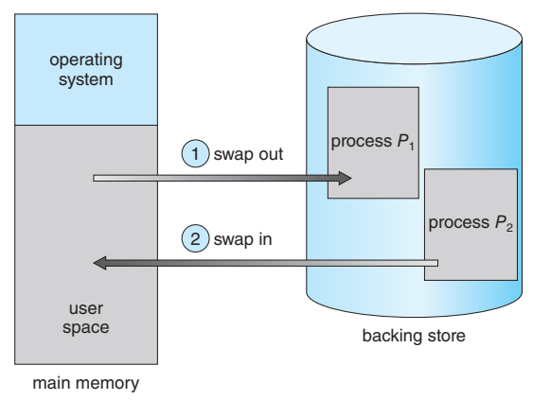

Slide 57
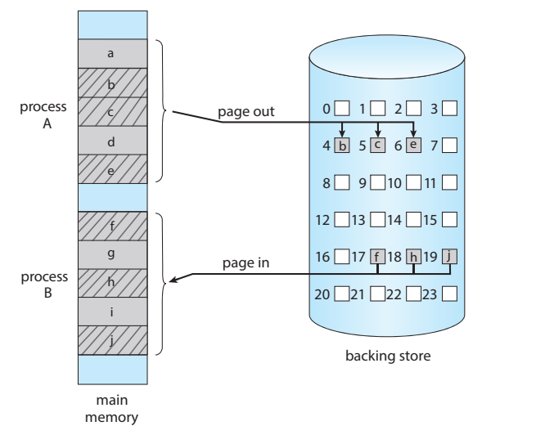

Slide 58
Swapping on Mobile Systems
Mobile systems typically do not support swapping in any form.
Mobile devices generally use flash memory rather than more spacious hard disks for nonvolatile storage.
The resulting space constraint is one reason why mobile operating-system designers avoid swapping. Other reasons include the limited number of writes that flash memory can tolerate before it becomes unreliable and the poor throughput between main memory and flash memory in these devices.

